Slide 1
Cuesta Training Committee Proudly Offers:
Who: Cub Scout Leaders
What: BALOO Training
When: October 28, 2023 at 8am to October 29 at 11am
Where: Pioneer Park
959 Valley Rd. Arroyo Grande, CA 93420
Cost: $40 per camper by Oct 14, $50 after
POC: Sean Tashma 760.219.4277 or cuestadistricttraining@gmail.com
Class Max size: 25 people
Theme: Western
Registration: Can register on council calendar or Scouting Service Centers.
Students need to bring Online BALOO and YPT certificate, BSA Medical Form A&B. Saturday Lunch, Dinner and Sunday Breakfast will be provided. Please alert staff of any food restrictions. Class A uniform for ceremonies, Class B for sessions. See attached gear list.
Cuesta District
Who should take BALOO?
The BSA requires that you have at least one BALOO-trained adult on every Cub Scout den or pack overnight outdoor event. That includes pack camping and Webelos den overnighters.
A BALOO-trained leader should be at any overnighter regardless of whether it is a pack, district or council event.
BALOO consists of two components: online and hands-on. You’ll need to complete both — in order — to qualify as a “Trained” Cub Scout outdoor leader and receive the BALOO recognition patch.
Online component: The online portion of BALOO is available 24/7 on the BSA Learn Center. Just log in to My.Scouting.org to begin or https://training.scouting.org/catalog and type BALOO in the search bar. The goal of the online portion is to make the best use of time to allow leaders to experience as much as possible during the practical hands-on training.
Practical, hands-on component: This 1.5-day course is designed as an introduction to the Cub Scout outdoor program for leaders interested in adding a camping component to their Pack activities.
Cut here ------------------------------------------------------------------
Name: __________________________________________
Address: ________________________________________
Phone: _________________________________________
Email: __________________________________________
Pack #: _________ Position: ________________________
[ ] $40 Fee enclosed (checks: Los Padres Council, BSA)
Basic Adult Leader Outdoor Orientation (BALOO)
Mail or bring in to: Los Padres Council
Attn: BALOO 2023
712 Fiero Ln
San Luis Obispo, CA
93401
Phone: 805-439-2885

Slide 2
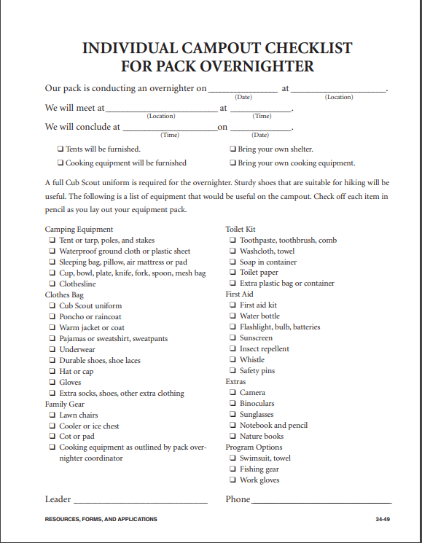
Oct 28,
Pioneer Park
Pioneer Park
NLT 800 am
NLT 1100 am
Oct 29
X
X
X
X
X
X
X
X
X
X
For BSA use only : 1-6801-516-20
X
X
X
X
X
X
X
X
X
X
X
X
X
X
X
X
X
X
X
Cubmaster Sean Tashma
760-219-4277

Slide 3
Scout Meal
This sheet must be filled out if you are attending and are
having any of your meals made by the Grub Master
I have NO food allergies
What are your food Allergies?
1)______________________________________________
________________________________________________
2)______________________________________________
________________________________________________
3)______________________________________________
________________________________________________
I have food allergies
I am a vegetarian
I am a vegan
For BSA use only : 1-6801-516-20
Name________________________ Event________________________
Date_________________________
Phone ______________________
This sheet must be turned in 1 week from the event to ensure the planning

