Slide 1
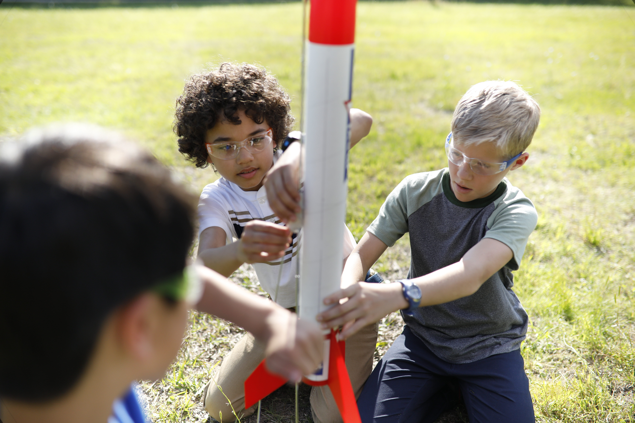
Fall Membership and Program Plan
Black Swamp Area Council

Slide 2
Fall Membership and Program Plan
Goals
SIMPLIFY, provide CONSISTENCY, and develop EXCITEMENT in HEALTHY UNITS to drive RETENTION
Get MORE Families in the greatest youth program there is SCOUTING!
Optimize and maximize our marketing efforts

Slide 3
Online registration and Unit Pin Management:
Make sure your Be A Scout PIN is updated. Committee Chairs, Charter Organization Representatives, and Cubmaster/Scoutmaster can approve youth online applications at http://my.scouting.org. Here are a couple resources to coach you along: Unit Pin Management Unit Pin Management (Family Scouting-including girls) *Charter Organization Rep. is the only member with access to edit Family Scouting status for the unit to accept girls*

Slide 4
Why accept online applications
Units can direct families attending to beascout.org and parents can register online and pay with credit card on their smartphone
Families can register for your unit anytime
Easy to use, no more paper forms, better serves todays families and millennials, reduces data entry errors and penmanship, NO MORE MISSING SIGNATURES

Slide 5
Fall Membership and Program Plan
All Northwest Ohio participating in September 6 (Black Swamp Area Coucnil & Erie Shores Council)
Most school districts begin their year in mid August. Create for the parents an easy way for the family to join Scouting.
Create exciting events for new scouts to participate within 60 days of joining.

Slide 6
Fall Membership and Program Plan
Campaign Theme:
ROCKET INTO SCOUTING
Flyers will list registration as “$2.75 per month” giving units flexibility to charge prorated 2018 amount or add in 2019 amount.
Online registration Beascout.org only charges prorated 2018 fee.

Slide 7
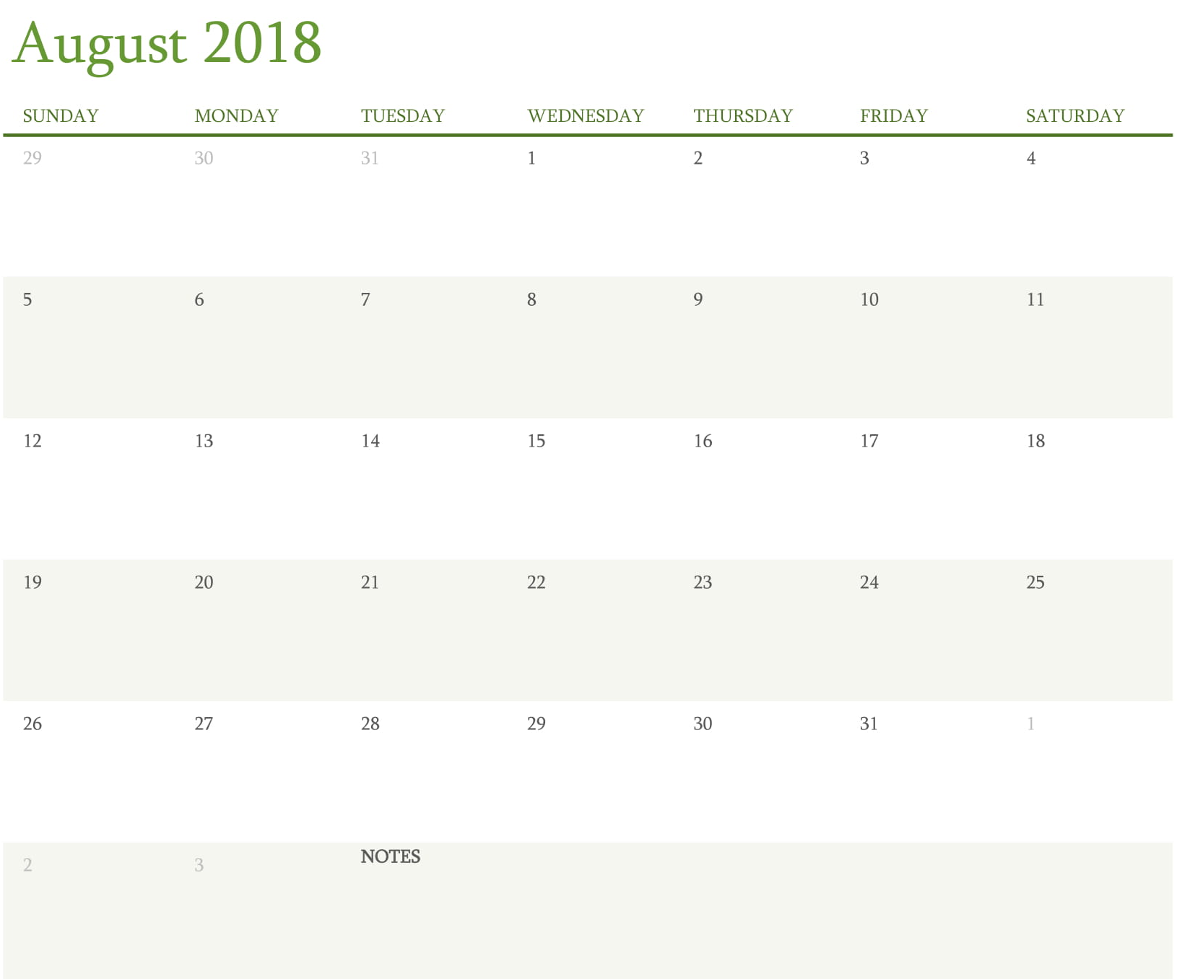
August 16 Yard Sign Blitz Day: Put yard signs at public places – library, restaurants, fire stations etc.
Items for distribution include: Recruiting flyers, stickers, yard signs, other promotional materials. “Meet the teacher nights” - school open houses, radio, and other media marketing
Membership Kickoff
AW, CH, GO
Flyers distributed, open house nights , school talks, social media push
Membership Kickoff OS
Yard Sign Blitz Day
Flyers distributed, open house nights , school talks, social media push
Flyers distributed, open house nights , school talks, social media push

Slide 8
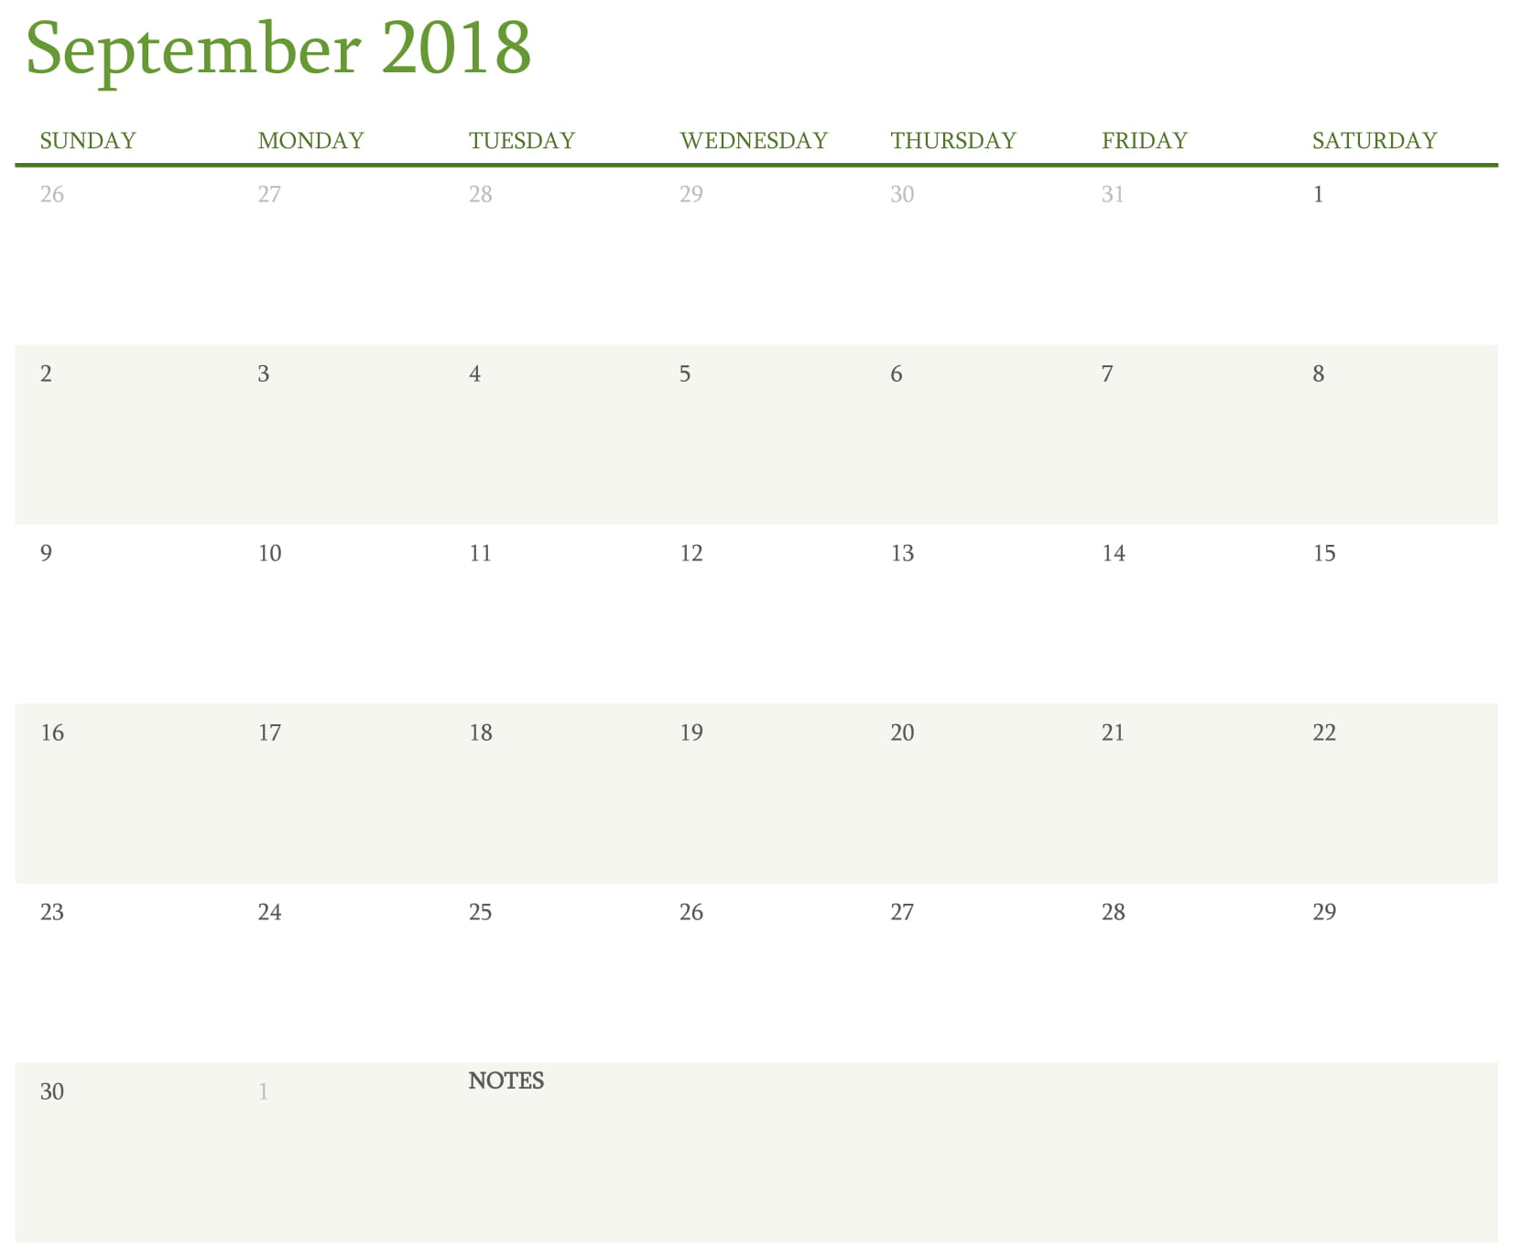
Flyers distributed, open house nights , school talks, social media push
Flyers distributed, open house nights, school talk, social media push
Sign Up Night for all Packs
Parent Orientation scheduled by the unit
First day to sell Popcorn
Popcorn sale distribution
Family Fun Day- Berry
Second chance signup nights

Slide 9
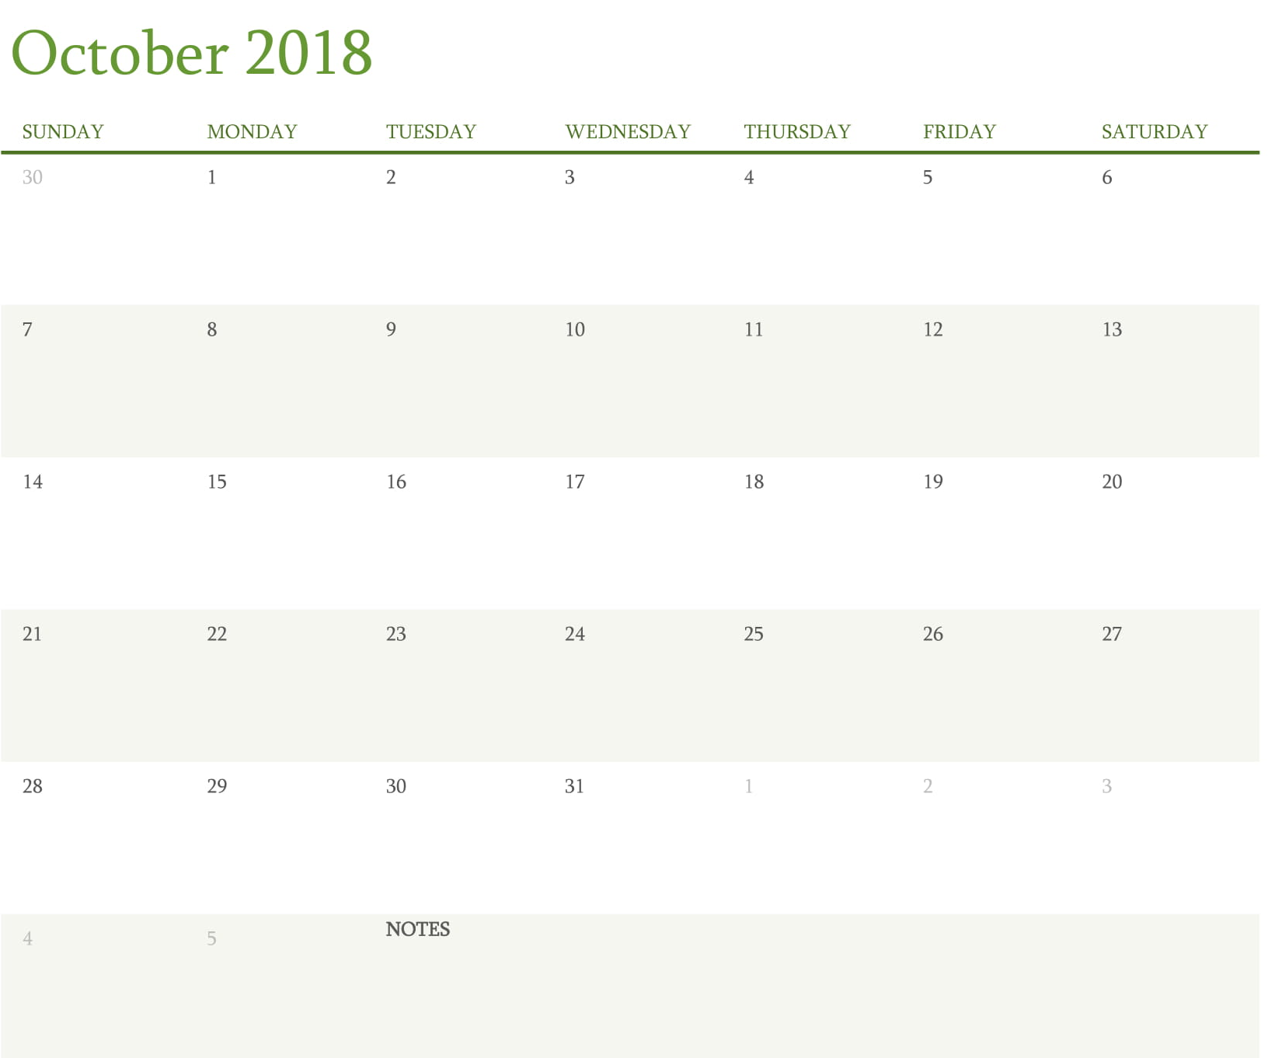
Second chance signup nights
Second chance signup nights
Second chance signup nights
Family Fun Day- Lakota
October 20 Family Fun Day at Camp Lakota. New Scouts recruited should bring finished rocket and receive their engine to launch.

Slide 10
What units can do to recruit by month
August
Put yard signs at public places, library, restaurants, fire stations etc.
Distribute recruiting flyers, stickers, yard signs
Have presence at school open house, school talks, promote through social media, email, as
September
Distribute recruiting flyers, stickers, yard signs
Have presence at school open house, school talks, promote through social media, email, parades, county fairs, word of mouth
September 22 & October 20 new youth attend Family Fun Days to launch there rocket

Slide 11
Paid and completed application September 6
Receive
Rocket
September 22 & October 20 Family Fun Days
Pack 2018-2019 calendar and district events
Next week’s parent orientation date
Mini Boys Life Magazine

Slide 12
Going through the leaders guide

